Slide 1
Cystic Fibrosis
Name
Institution
Course
Instructor
Date

Slide 2

Situation
He is anxious and tired
He has inflammatory joints
Bluish lips and breaths through tightened lips
Sticky phlegm
Notes:
The 37-year-old patient is currently experiencing severe respiratory suffering. He looks anxious and tired. He has inflammatory joints because he has secured his arms on the arms rest of the wheelchair. His lips are bluish, and he is breathing through tightened lips. He is occasionally generating a productive cough with thick, green, and yellow-brownish sputum. This is the case despite that the cough he is producing is weak. Additionally, the phlegm is so sticky in such a way that he cannot cough it up. These experiences make it hard for him to walk and therefore is rode in a wheelchair. He produces a wheezing sound while breathing.

Slide 3
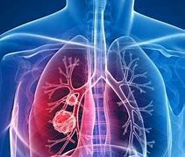
Background
Diagnosed with Cystic Fibrosis at 2 years
Hospitalized twice every year
Excess bronchial secretions
Notes:
The patient was diagnosed with cystic fibrosis at the age of 2 years. Due to the various pulmonary complications that resulted from cystic fibrosis, he would be hospitalized two times every year. His medical history revealed that the bronchial secretions of his body were excess, he had lingering pulmonary infections, and he had many bronchoscopies that helped him in the treatment of plugging mucus. Because of these regular visits to hospitals, he became very familiar with the hospital staff. The office staff always worked on ways to control the complications that he always experienced. The diagnosis of the condition was a great shock to him because he started the medication life at a tender age.

Slide 4
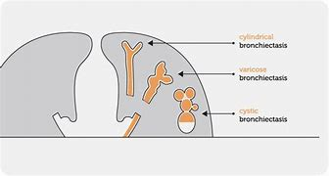
Background
Developed varicose bronchiectasis at 31 years
It resulted from ventilatory failure and infections on bronchial airway
The last time he was hospitalized was six months ago
He has once been in a mechanical ventilatory for ten days
Notes:
At 31 years, the patient developed varicose bronchiectasis at the lower part of the lung lobes. This compromised the cystic fibrosis complication even further. The varicose bronchiectasis was primarily a result of ventilatory failure and the patient's infections of the bronchial airway. He was lastly hospitalized six months ago before his acute respiratory acidosis condition. He was once under mechanical ventilatory in which he went for ten days. Upon being discharged, some tests on his arterial blood revealed that he had a pH of 7.38, PaO₂61, HCO54, and SaO₂91%.

Slide 5

Background
The infection may be passed to others through;
  Coughing
  Playing together
  Sharing equipment
  Sharing food and drinks
Notes:
Through series of his visits to a hospital, a specialist warned that patients with cystic fibrosis could pass the infection to other people through such ways as close contact, coughing, paying together, sharing equipment, rooms, or drink. He warned that the bacteria that may be harmless to people without cystic fibrosis could be harmful. Furthermore, cross-infection is riskier when the infected and uninfected stay together for a long time, such as at home (Rey et al., 2019). Therefore, treatment of this condition demands that the patient is in a segregated room with necessary facilities to enhance their wellbeing. The patient is thus brought to an emergency room on this day (Bell et al., 2020).

Slide 6
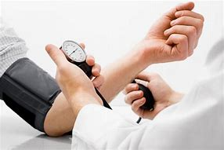
Assessment
Blood pressure test shows 164/146
Pulse rate at 144 per minute
Respiratory rate at 28 per minute
X-ray test shows translucent lungs
Notes:
He is tested for blood pressure which reveals that it is high at 164/146. The pulse rate test shows it stands at 144 per minute while the respiratory rate is 28 per minute. There is also a bilateral decrease in tactile fremitus for chest palpation. Through auscultation, the patient produces loud wheezes. His heart also diminishes in sound. The x-ray image of the patient's chest is taken, revealing that there are fields of lungs that are translucent, and the diaphragms are depressed. The respiratory care specialist directs that the concentration of the patient is raised to 4L/Minute. His body mass index was also slightly lower than the recommended one.

Slide 7

Assessment
Fed the patient with;
  Vegetables
  Fruits
  High-fat foods
  Food rich in calories
Notes:
To achieve the desired body mass index (BMI), the specialists sought to reach a level above the 50th percentile. This is the recommended BMI by the CF Foundation. They ensured that the patient was fed vegetables, fruits, high-fat foods, and high-calorie foods to achieve this. It is recommended that a person suffering from cystic fibrosis should eat twice the calories that an average person takes every day. The specialists ensured that the patient ate plenty enough to achieve the calories. Since water is also essential in their bodies, they confirmed that he took enough water every day. As part of the diet, some additions included milk, avocado, and protein powder (Rey et al., 2019).

Slide 8

Assessment
Treatment through
  Clearing the airway
  Inhaled medication
  Nutrition therapy
  Body exercise
Notes:
They started a treatment program to help him live longer to help him go through life without problems. The treatment centered on four primary areas; clearing the airway, inhaled medication, nutrition therapy, and body exercise. Clearance of the airway involved loosening the sticky and thick mucus to remove it from the lungs. This was helpful because it would improve the functioning of the lungs and reduce the infections that would likely infect the lungs. Medications such as inhalers were helpful because they would help the patient fight and prevent infections. The pure oxygen he inhaled would help him prevent blood pressure in the lungs (Bell et al., 2020).

Slide 9
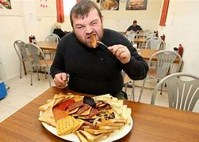
Assessment
Noted improvements
  Gradual decline in the rate of wheezing
  Loosening of mucus
  Started eating more food
Notes:
The treatment was helpful because it helped manage his condition to a level that he felt relieved. The rate of wheezing sound slightly declined, and he could no longer struggle breathing as before. The mucus was no longer as sticky as initially, and the color changed to less green and yellow. Despite that the patient would not recover fully, the medication was helpful, and the healthcare professionals realized a significant transformation of his health. At this point, he started eating more than he used, although not enough for his body. This progress showed that the medications and therapies that the professionals administered were helpful (Rey et al., 2019).

Slide 10
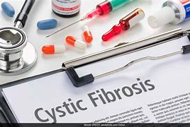
Recommendations
We can conclude that;
  Cystic fibrosis is life-threatening
  The action by the child’s parents was helpful
  Treatment and therapies were helpful to the child
Notes:
To sum up, it goes without saying that cystic fibrosis is a life-threatening condition. For this reason, it calls for serious intervention by experienced specialists. Life would be more miserable for the child if the specialists took no action. The initiative for concern by the patient’s parents was beneficial during his tender age. Without it, the life of this patient would be at stake. The overall treatment of the patient boosted his life to a greater height. The patient was kept away from others to avoid inter-transmission. The closeness to experienced professionals helped to monitor his progress, and the child was well taken care of better than he could while at home (Bell et al., 2020).

Slide 11
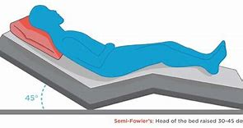
Recommendations
Further care plan;
  Three times physical exercise per day
  Rest during intervals
  Collaboration of patients with respiratory care professional
  Staying in a semi-fowler’s posture
Notes:
As part of a further care plan, I recommend performing physical exercises at least three times daily. This will help boost the need for more oxygen in the body. However, the movement should be accompanied by resting time during the intervals. Rest is necessary because it will help him be free from fatigue. Additionally, I recommend that the patient collaborates with the specialist in charge of respiratory care so that the ventilation he administers is non-invasive. Further, I would suggest that the patient stays in a semi-fowler's posture. This would enhance the expansion of the lungs and decrease the collapse of the airway (De Boeck, 2020).

Slide 12

Recommendations
Parents should be aware of their children’s health status
Civic education can play this role effectively
It can prevent escalation of cystic fibroids into a bigger issue
Notes:
As parents, there is a need to be aware of what their children undergo. Any detectable unfamiliar sign of ailment should be acted upon to avoid serious complications. This may be necessitated by civic education, where the parents are taught about the basics of parenting. Additionally, there is a need to be aware of these genetic complications that may be passed to the children. With this knowledge, the parents can take early measures to prevent the conditions from escalating into bigger issues (Rey et al., 2019).

Slide 13

What I Learned
I learned that one can inherit Cystic Fibrosis from Parents. I also learned that it can be transmitted from one person to others through sharing foods and drinks, coughing, playing together, and sharing equipment. I learned that once diagnosed with Cystic Fibrosis, the patient should have meals comprising of vegetables, fruits, high fat foods, and foods rich in calories. It is important for the patient to undergo therapies to enable him get through the condition. Lastly, I learned that parent need to know about the health status of their children to diagnose the condition earliest possible. This will help in curbing the possible serious complications that are likely to escalate.

